Slide 1

LocAid: eBay for Hospitals
Team 4.06
May 16, 2021

Slide 2
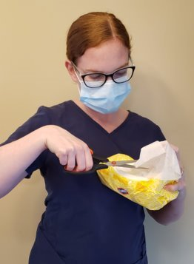
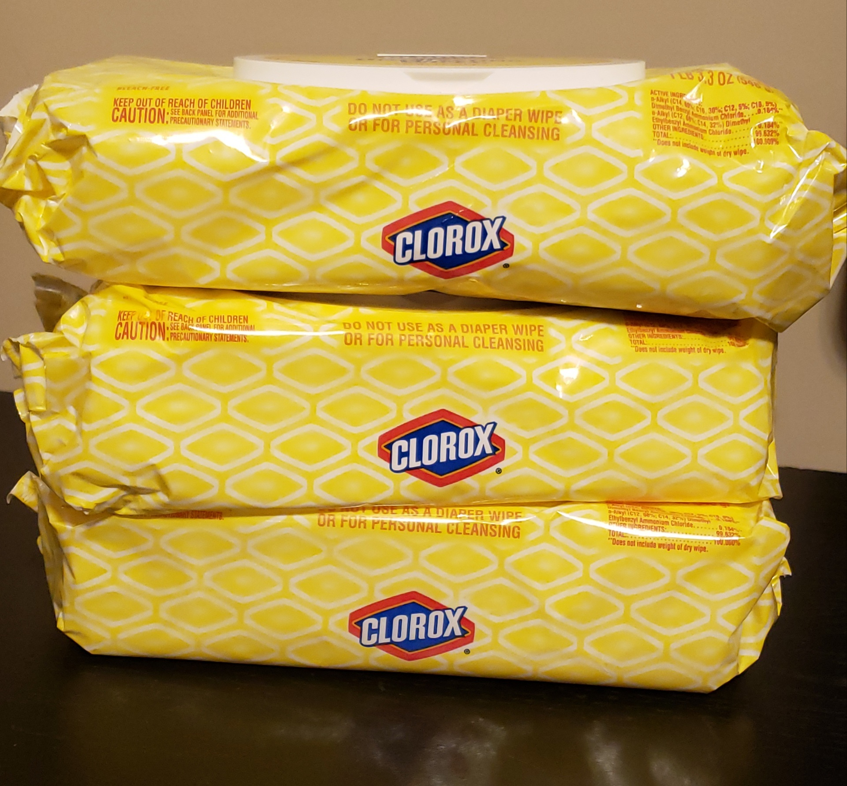
Team 4.06
I need more wipes!
Our wipes are about to expire, and JCAHO is coming!

Slide 3

Lack of Resource Optimization
Team 4.06
NO interhospital communication
Supplies expire before use
NEED TO create revenue from excess
Items hard to get or backordered

Slide 4
Impact on Patient Care - Medical Supplies Shortage
Team 4.06
Source: AHA analysis of survey data from 820 non-federal, short-term acute care hospitals.
Survey completed in June 2011
4

Slide 5
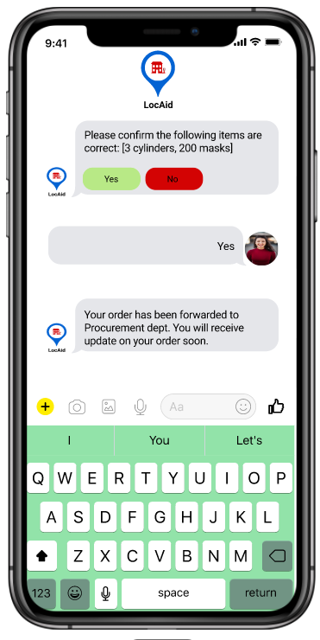
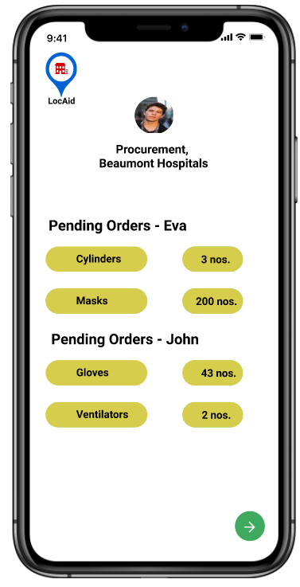
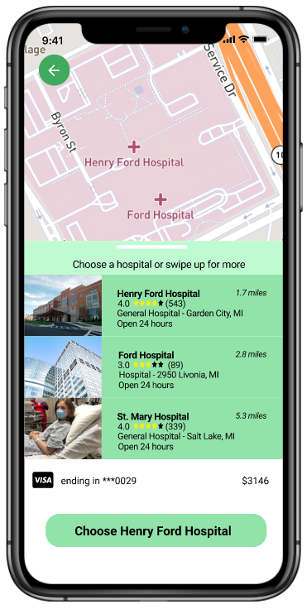
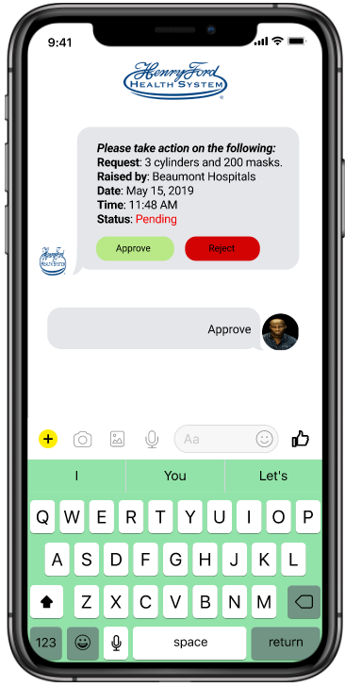
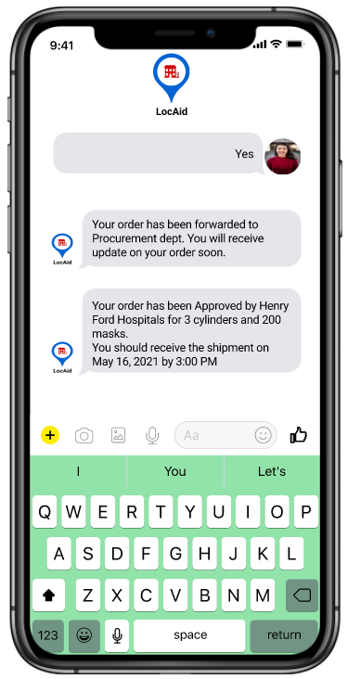
LocAid: eBay for Hospitals
Team 4.06
1
2
3
4
5
Link to UI in Figma: https://tinyurl.com/Team406-LocAid

Slide 6
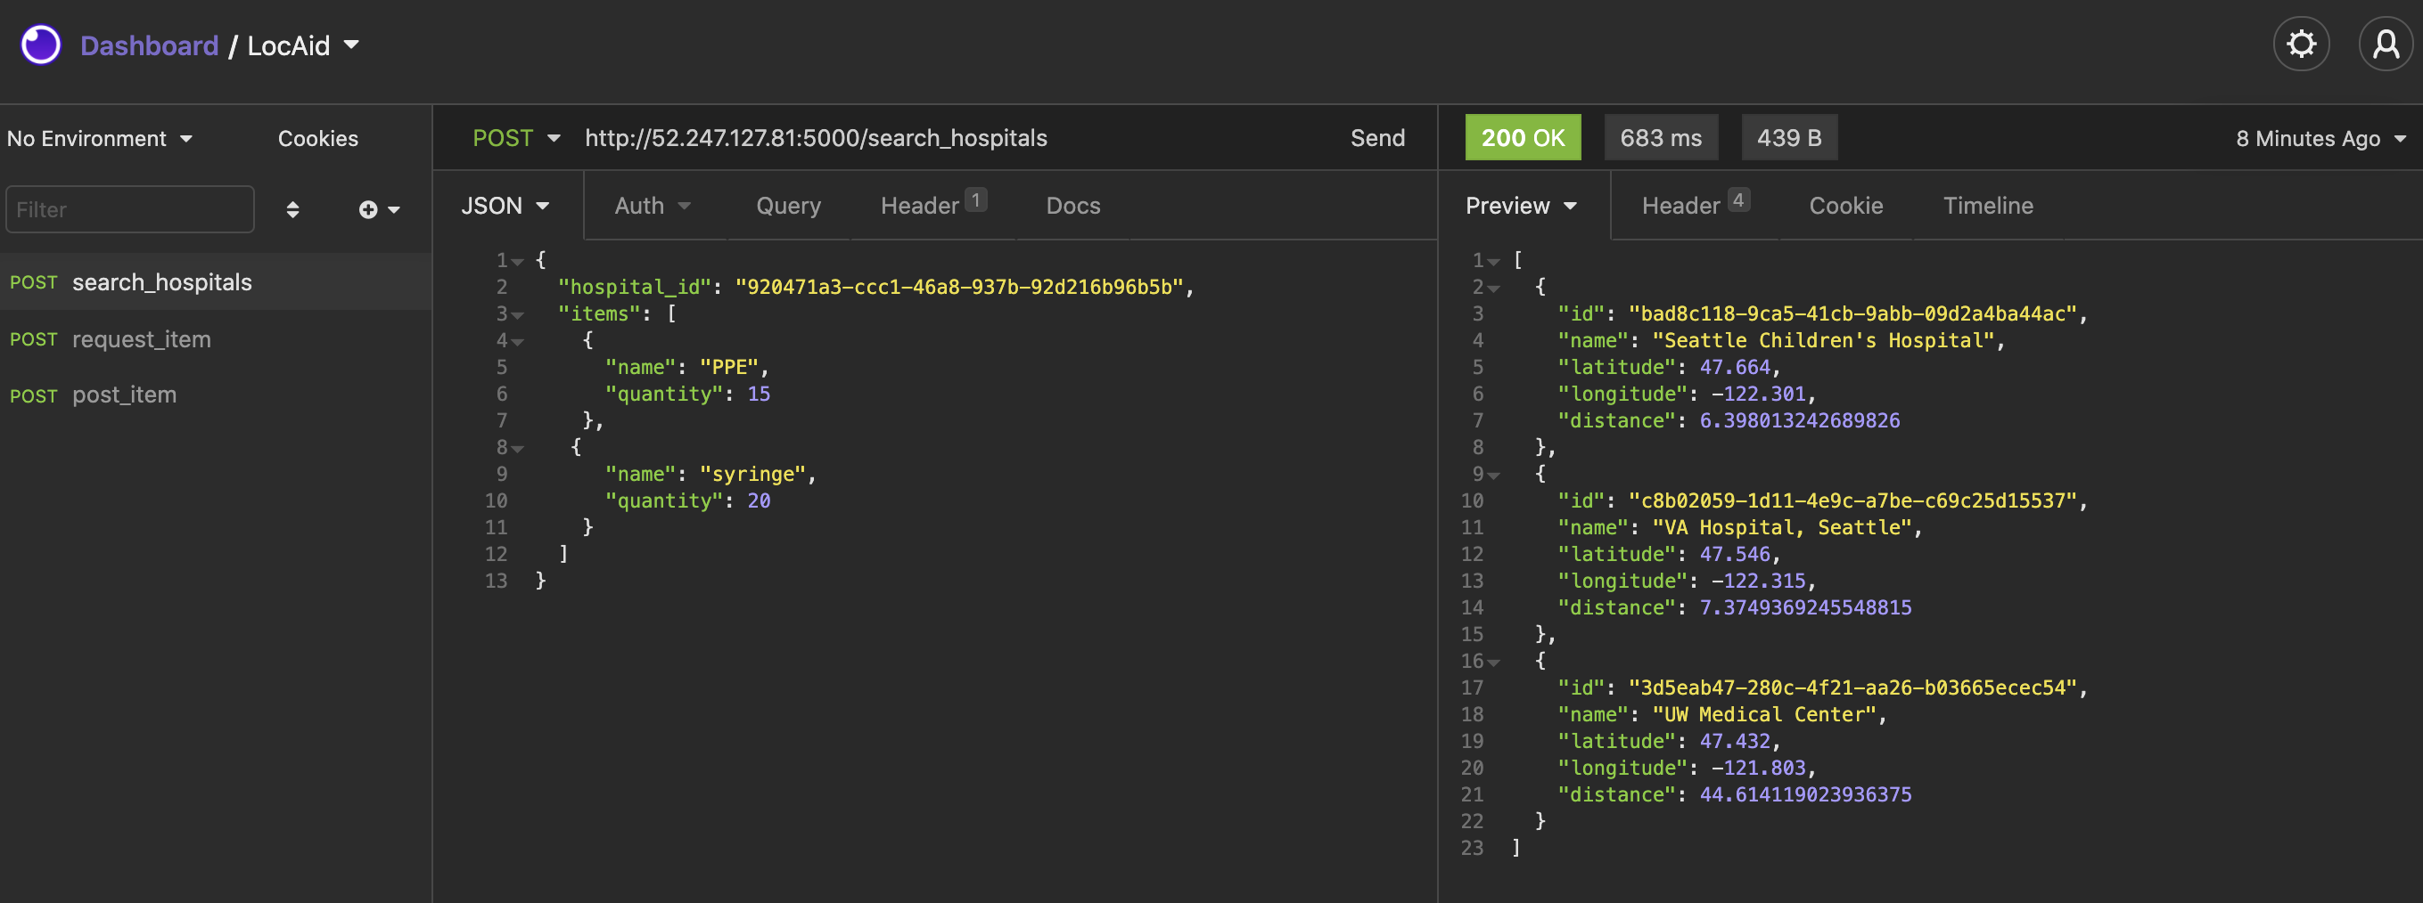
Application – Chat Bot Hospital Search
Team 4.06

Slide 7
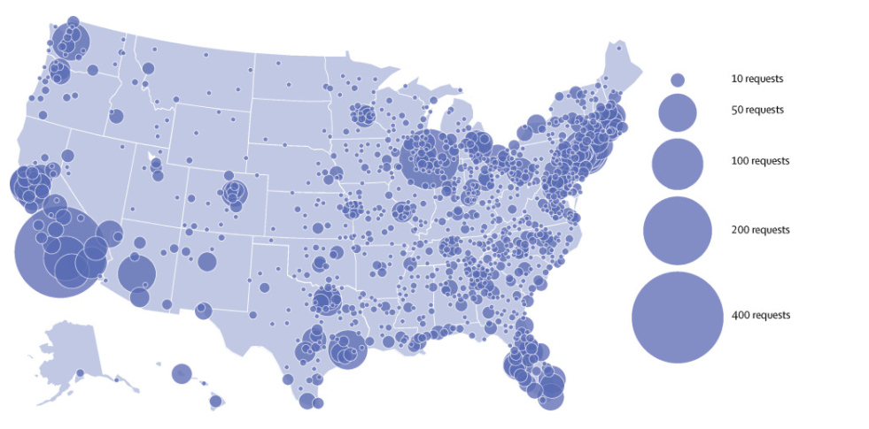
Market Size
Team 4.06
6,090 hospitals in the United States
In 2020, a single hospital put out 400 requests for PPE masks
LocAid is the solution!

Slide 8
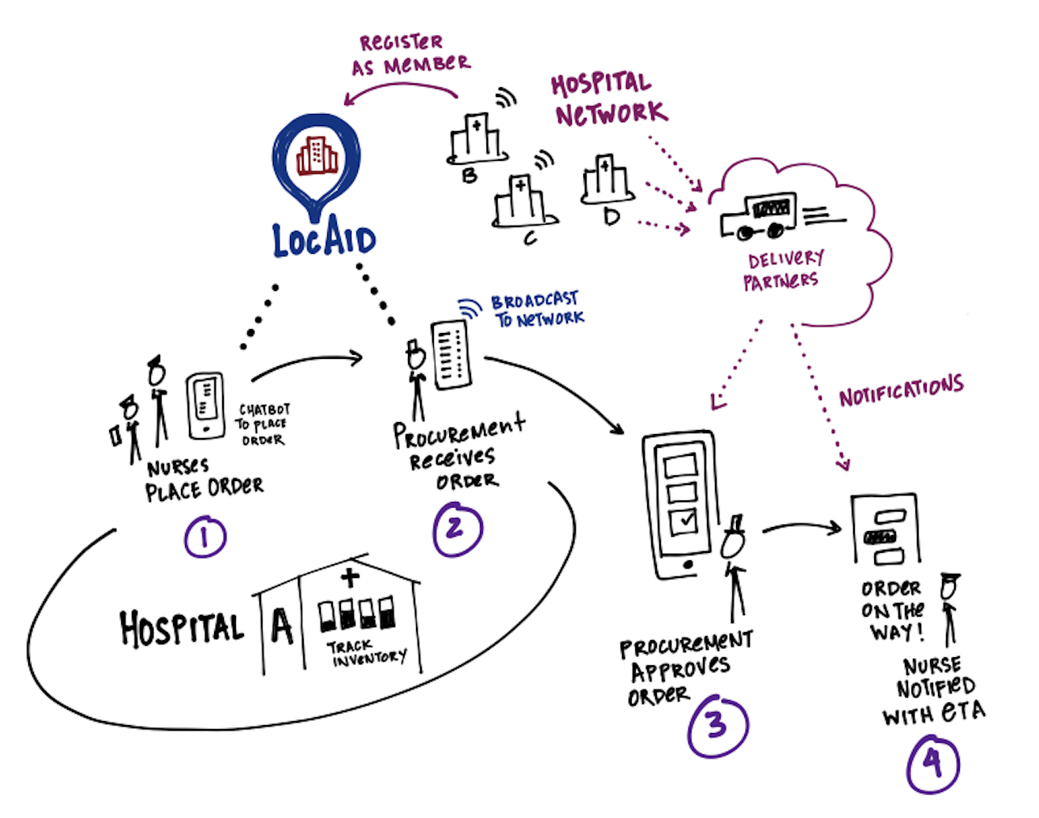
Business Plan
Team 4.06
Notes:
This slide wll be the business model-> will take this global, will add hospitals to the network

Slide 9
Costs, Revenue, and Funding
Team 4.06
Costs:
Monthly - Virtual Machine: $85.46
Monthly - PostgreSQL Database: $49.64
Revenue:
$11.9M spent on supplies per hospital * 6,090 hospitals in the U.S. * 1% of market share * 2% service fee
= $14,494,200 in U.S. market value!
Possible Grants: Covid-19 Small Business Grants, SBA Healthcare Grants, New Development Initiative Funds.
Notes:
Number of hosptials in network + estimated revenue (service fee for each transaction-1%). Will look for covid funding.

Slide 10

LocAid vs. Others
Team 4.06
Services | LocAid | Competitor 1 | Competitor 2 | Competitor 3
Intuitive & Unique | Yes!
Cost for Users | Low 2% service fee
Platform | Microsoft Azure
Hospital Users | Nurses and Procurement
Notes:
Find PPE competitor
Ours is unique due to AI chatbot
On backend, tied to hospital's existing inventory system (the

Slide 11

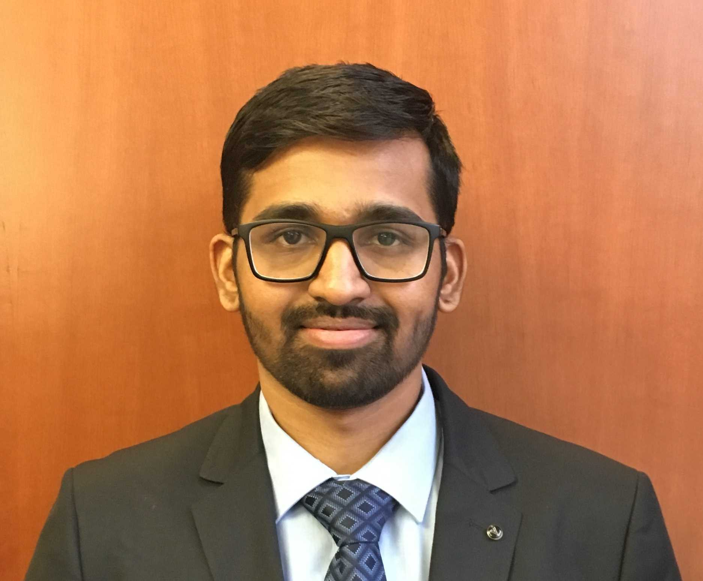
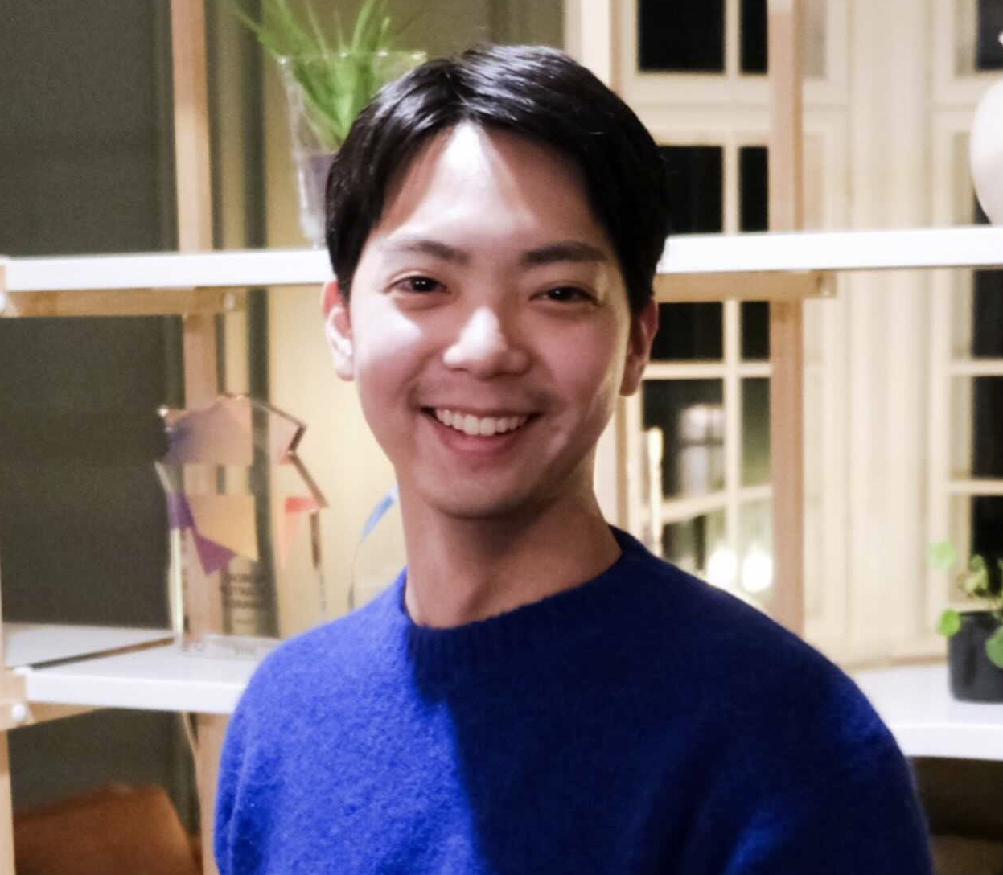


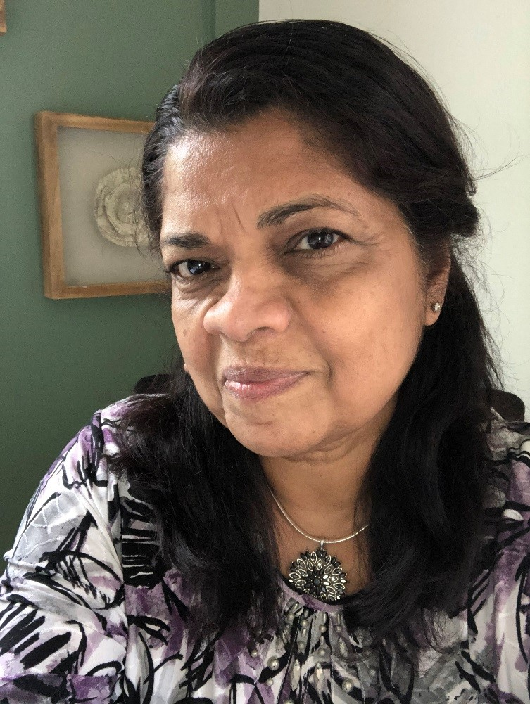
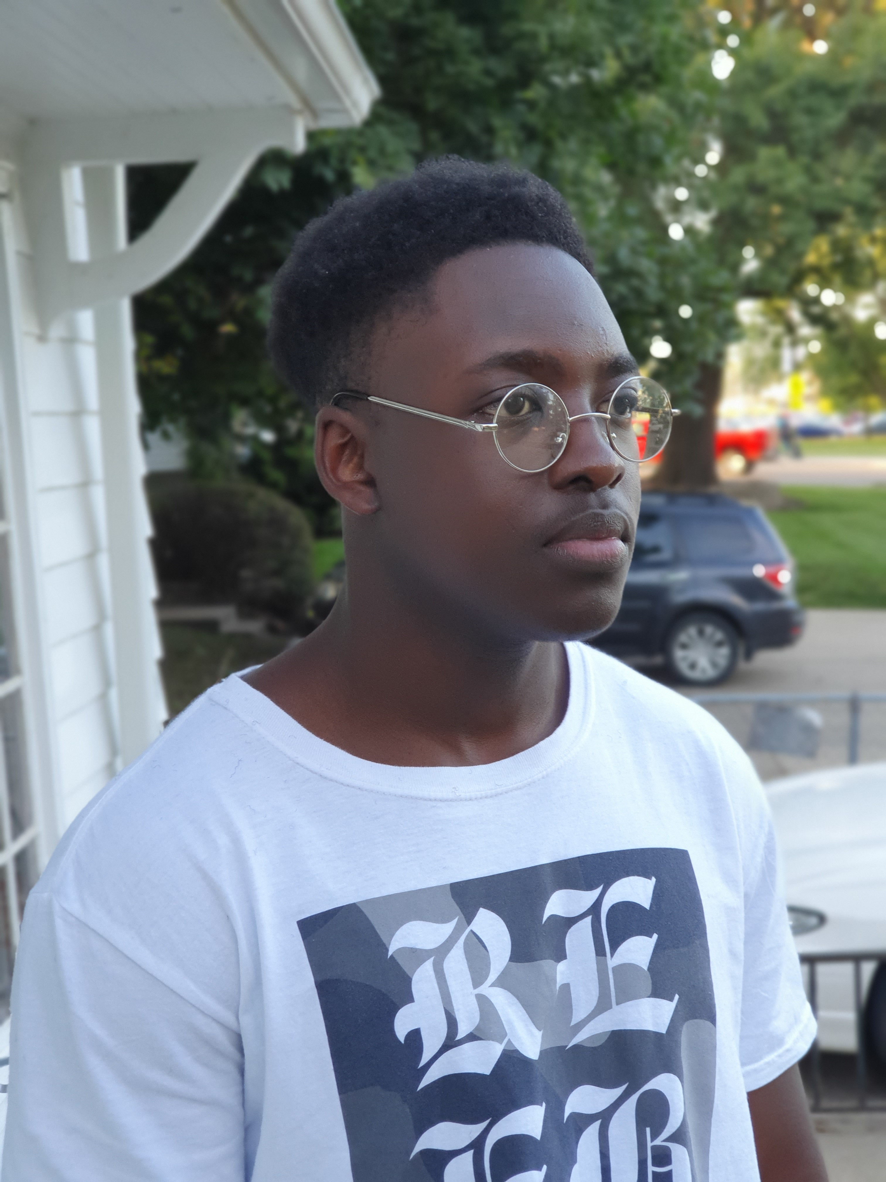
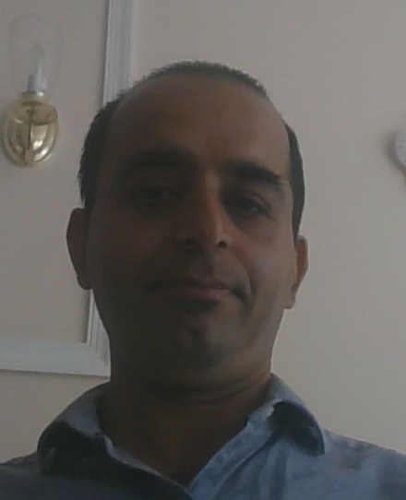
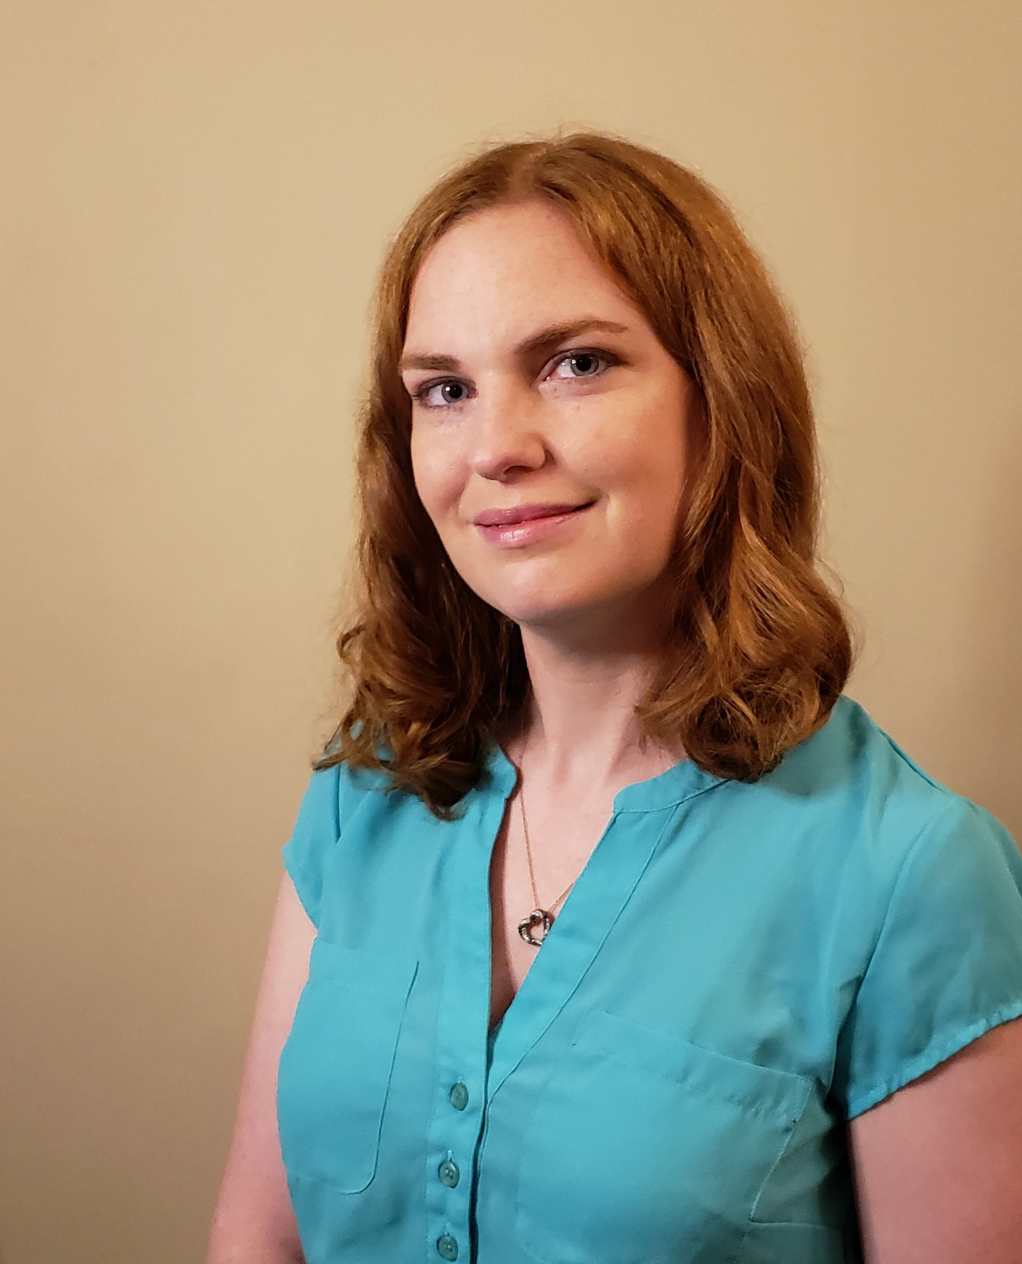
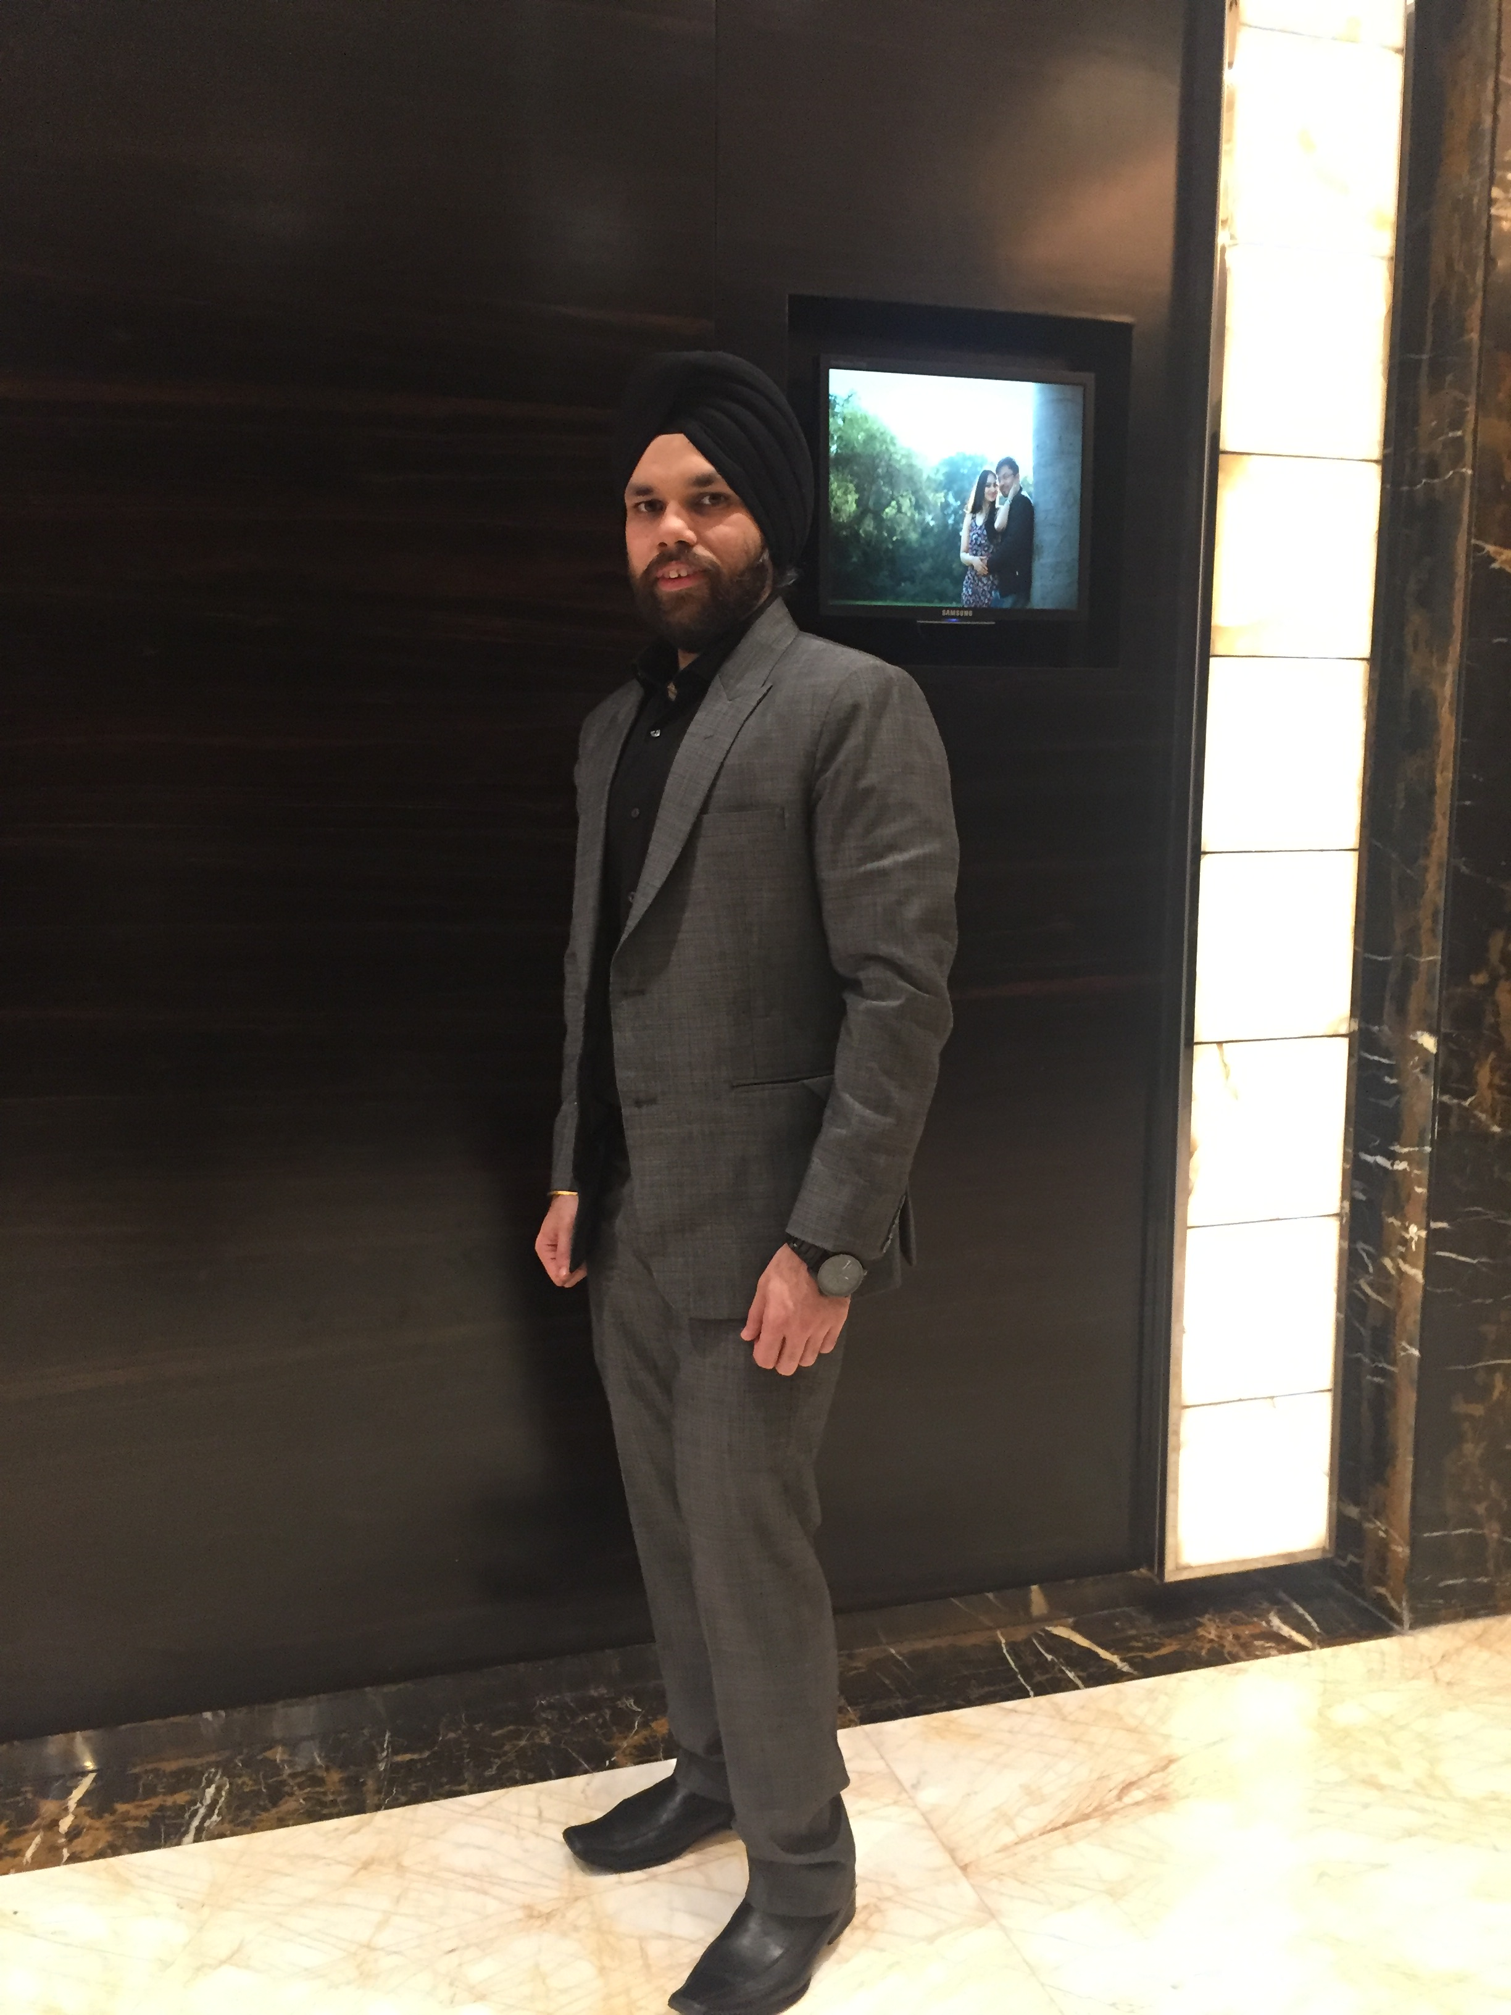
Meet Team LocAid....eBay for Hospitals
Team 4.06
P Mungikar
Program Manager /
UI Designer
Pmungika@umich.edu
Akihiro Inui
Data Scientist / Software Engineer ai@corti.ai
Ashika G.
Product Manager & Pitch Developer
Ashika.gop@gmail.com
S Adedeji
Student(Computer Science)
adedejisalim01@gmail.com
Anilkumar
Punjabi
Mentor
punjabi.anil@outlook.com
Fatima Tisseverasinghe
Nurse Leader
Kathleen Malouf
Registered Nurse
KathleenEMalouf@gmail.com
Deepjyot (DJ) Singh
Associate Director /
Cloud Architectd
Deepjyot.singh@outlook.com
Thank you for this opportunity!
11
Notes:
Our team is comprised of diverse backgrounds and I hope you join our mission to empower and connect patients, and make communication and medical information accessible and inclusive. Thanks for your attention!

